Slide 1
Stock Tracking Project
MIDTERM PRESENTATION

Slide 2
Stock Tracking Project
Our stock tracking project is prepared for functions such as buying, selling and controlling the number of products in the storage.
Goals: Our project aims to streamline the actions of the user and to minimize the error rate by informing the user.
Domains: This project is mainly prepared for the health sector, but with small changes to be made on the project, all service sectors will be able to use it.
Project users and their needs:
The biggest need of this project is to record every transaction.
If the transactions are not recorded, the user is responsible for the problems experienced.
Every transaction performed is recorded in the smallest detail by the system and stored for later use.

Slide 3
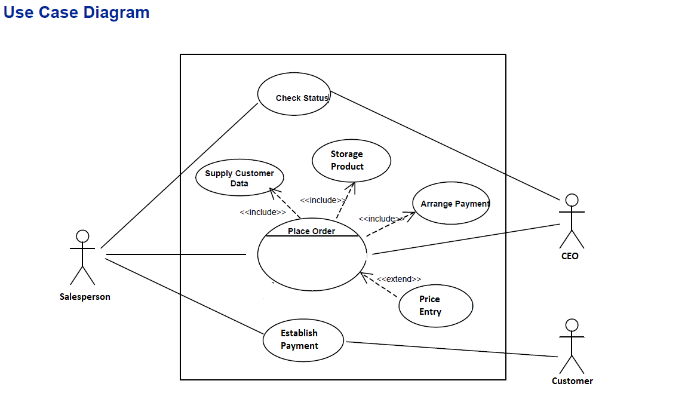

Slide 4
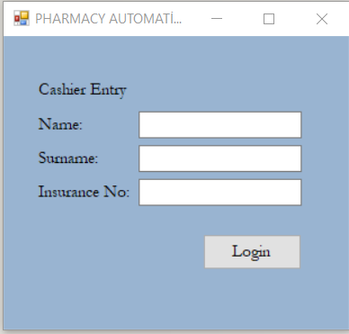
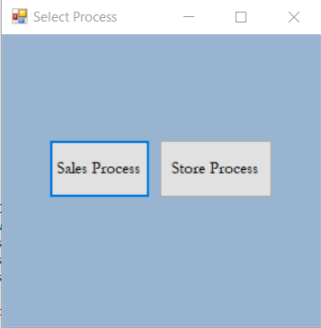

Slide 5
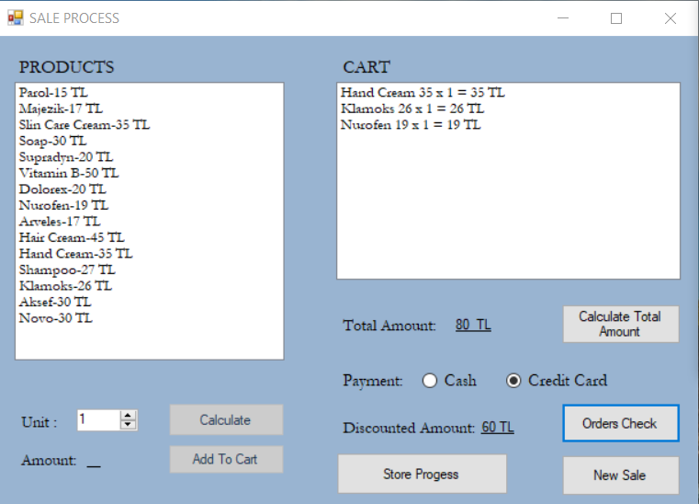
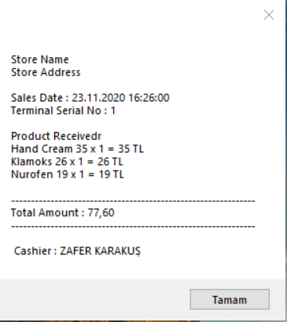

Slide 6
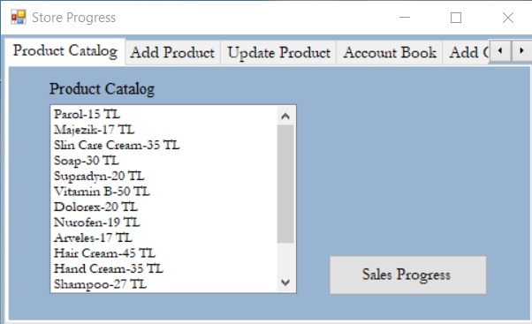
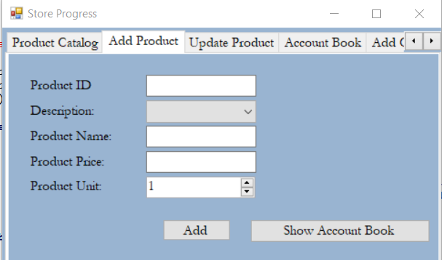

Slide 7
Functional Requirements
Security: Users must enter a personal user name and password in order to log into the system. No action can be made without entering the username and password. In this way, all information is protected.
Accuracy: The system records every transaction made by the user in days, hours and minutes. Each recording can then be checked optionally. In this way, it is easy to find out who made mistakes, how and when.
Interoperability: The system carries out sales and storage operations at the same time. In this way, the stocks are updated after each sale and the user can instantly observe the number of products

Slide 8
Non-Functional Requirements
Performance: The system is capable of providing access to many users at the same time. Thus, even if many users enter the system at the same time, the system will not crash or give an error. The system can respond quickly to the action of a particular user under a given workload.
Usability: The website’s interface is user-friendly and easy to use.
Availability: Customers can buy the products throughout week at any time during the day. In the case of unplanned system downtime, all features will be available again after one working day.

Slide 9
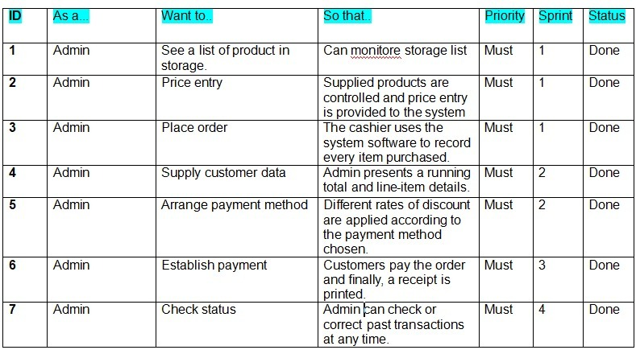
PRODUCT BACKLOG

Slide 10
What we learned with the Project?
Customers generally want the program to be simple and understandable. The simpler and more useful the project, the more satisfied the customer.
The most important event in a project is teamwork. Team members should properly perform the task assigned to them.
Every task performed should be carefully controlled by all team members during the meetings.
When team members realize that they cannot fulfill the task assigned to them, they should contact other members, inform them and seek help.

Slide 11
While preparing a project, it is necessary to learn from mistakes. Mistakes made should be experience for team members.
Team members should not let each other down and support each other in all matters. This creates an atmosphere of trust.
Every step of the project should be planned and followed properly.

Slide 12
ÜMİT ZAFER KARAKUŞ 161805020
MEVLÜT BATUHAN SAAR 161805030
BARAN YILDIZ 151805042

